Slide 1
6040 Data Mining Application -- Bank Deposit Subscription
Songyuan Luo
Northeastern University

Slide 2
Contents

Slide 3
Contents
1.Introduction
2.EDA
3.Decison tree model
4.Factor analysis
5.SVM

Slide 4
Introduction

Slide 5
Introduction
The data set is retrieved from UCI Machine Learning Repository.
Constraint by time, I only analyzed the sample data set.
The data set is consists of 12 variables and 45211 observations.
The variable names are: age, job, marital, education, default, balance, housing, loan, contact, day, month, duration, campaign, pdays, previous, poutcome and y (outcome variable).

Slide 6
EDA

Slide 7
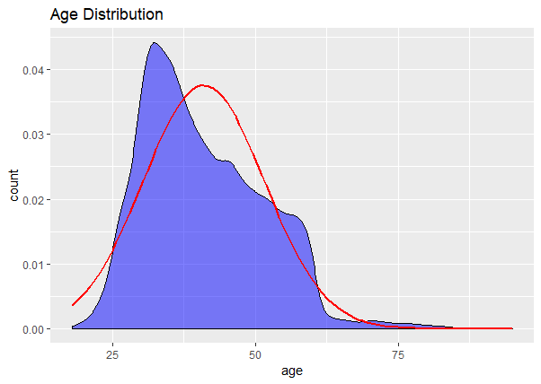
Age Distribution
As we can see the distribution is right skewed and people who are more than 55 years old decreased sharply.
The red line represent normal distribution for guidance.

Slide 8
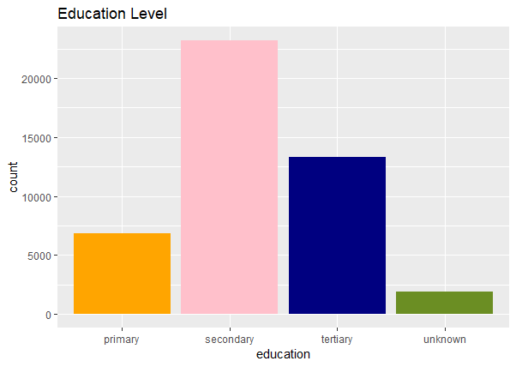
Education Level
This graph shows us people with secondary education level accounts for large majority, about 55%, and people with tertiary education level accounts for 28%.

Slide 9
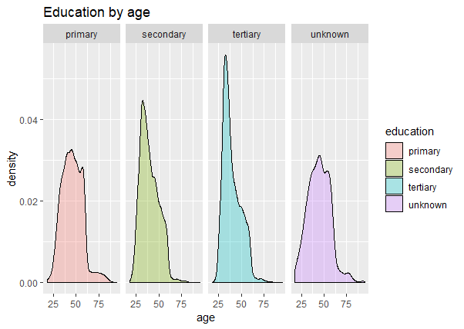
Education by age
This graph shows us how four education level people’s age distributed. The higher education level people have, the younger they might be.

Slide 10
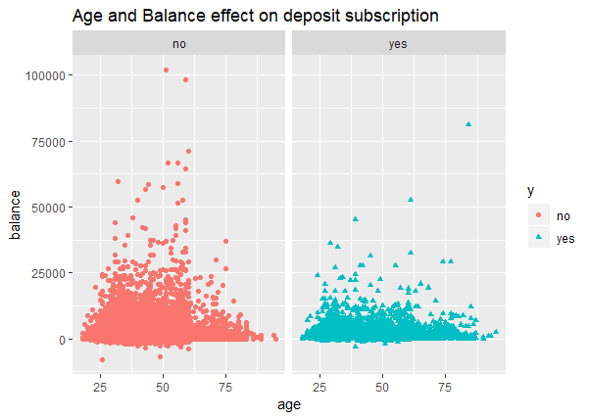
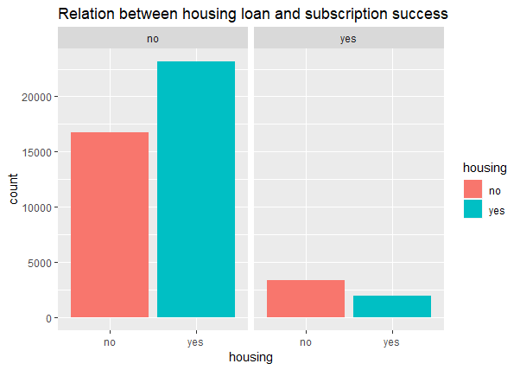
Age, Balance and Housing loan effect on Subscription Outcome
The barplot below shows there is no relation between whether have housing loan have effect on outcome.
The scatterplot is showing there is no relation among age, balance and subscription outcome.

Slide 11
Decision tree model

Slide 12
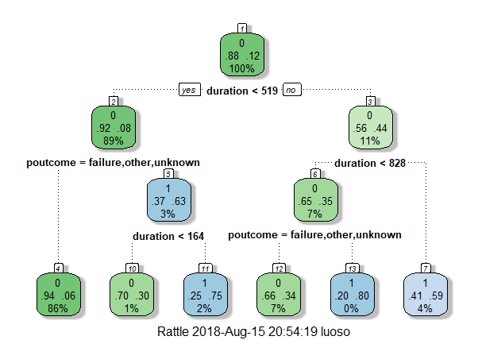
Decision tree model
The decision tree model shows 86% of failed deposit subscription comes from those who spent less than 519 seconds or 8.7 mins with agents, and didn’t have marketing campaign before.

Slide 13
Outcome
The outcome is not satisfying as the MSE is 0.42, which is too high.
I assume the number of variables is too many; Maybe using factor analysis to find out latent factors.

Slide 14
Factor analysis

Slide 15
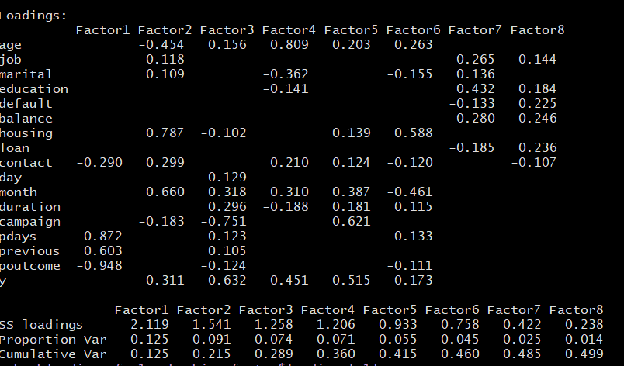
Factor analysis (no rotation)
Though there are many factors with relatively high uniqueness, using rotation will benefit the interpretation.

Slide 16
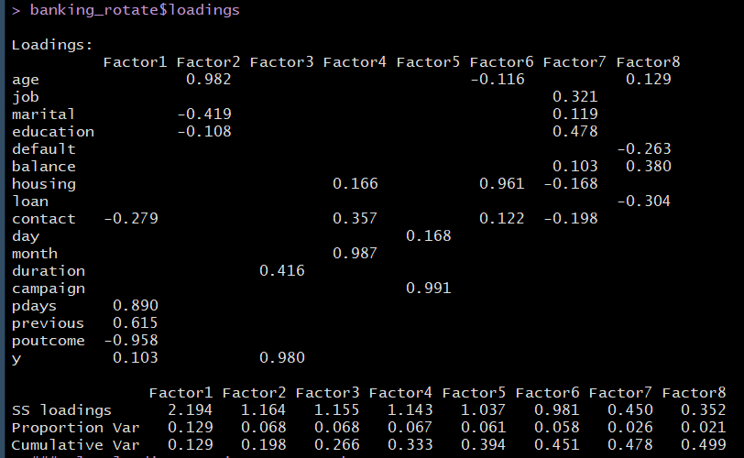
Factor analysis (with rotation)
For factor 1, previous campaign outcome and days after previous campaign are more important. Factor 2: age. Factor 3: y (the outcome of deposit subscription). Factor 4: month of last contact. Factor 5: number of campaigns performed for this client.

Slide 17
Supporting vector machine

Slide 18
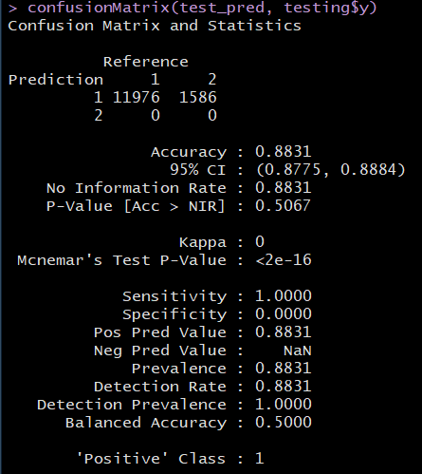
Outcome
The accuracy of the SVM model is 88%, which is good enough for guidance.

Slide 19
Supporting vector machine

Slide 20
Conclusion
As I mentioned before, the dataset is collected from 2008 to 2013, after financial crisis, certain solvency indicators used commonly before are not effective nowadays. In fact, we can know from factor analysis that only housing loan still have effect on the subscription, other factors like education, balance or job are no longer useful. This report is not to provide reason for this phenomenon, I can only draw the conclusion that with supporting vector machine model with 88% accuracy, this can really help employees and the bank to work more effective. Factors that need to be taken into account are the outcome of last campaign, duration after last campaign, housing loan, age as well as month since last campaign. Most of the factors are about last marketing campaign.
For further improvement, I will try multi gradients to optimize the supporting vector machine model, or even use artificial neural network on the whole population banking data set.

